Slide 1
a PENCIL is sensitive to the class_weights (cw) parameter setting
Non-responder (4301)
Responder (2049)
Non-responder (2560)
Responder (9)
Rejected (3781)
Non-responder (2365)
Responder (1004)
Rejected (2981)
True label
cw = 1:1 (default)
cw = 1:2
b PENCIL is sensitive to input gene order
Non-responder (2006)
Responder (674)
Rejected (3670)
Non-responder (2425)
Responder (1135)
Rejected (2790)
Non-responder (1843)
Responder (504)
Rejected (4003)
Genes ordered by variance (low to high)
Genes ordered by mean expression (low to high)
Genes ordered by name (A to Z)
c PENCIL is sensitive to input cells
Non-responder (1110)
Responder (14)
Rejected (3345)
Non-responder (2958)
Responder (1166)
Rejected (3034)
Non-responder (2767)
Responder (52)
Rejected (5724)
70% samples (using original CD8T annotation)
All samples (CD8T annotated by celltypist)
All samples (CD8T annotated by singleR)
Figure 1. Sensitivity of PENCIL to input parameters and data.
Notes:
Hi everyone, today I will present our recent work on predict pan-cancer ICB response using machine learning.

Slide 2
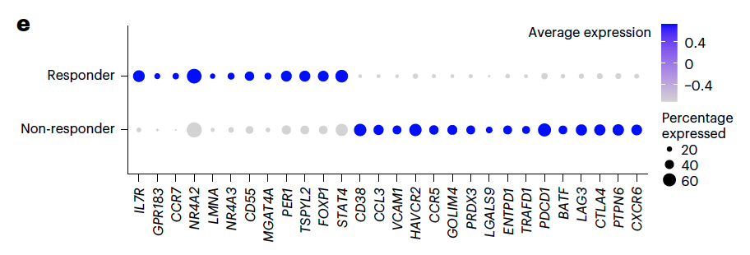
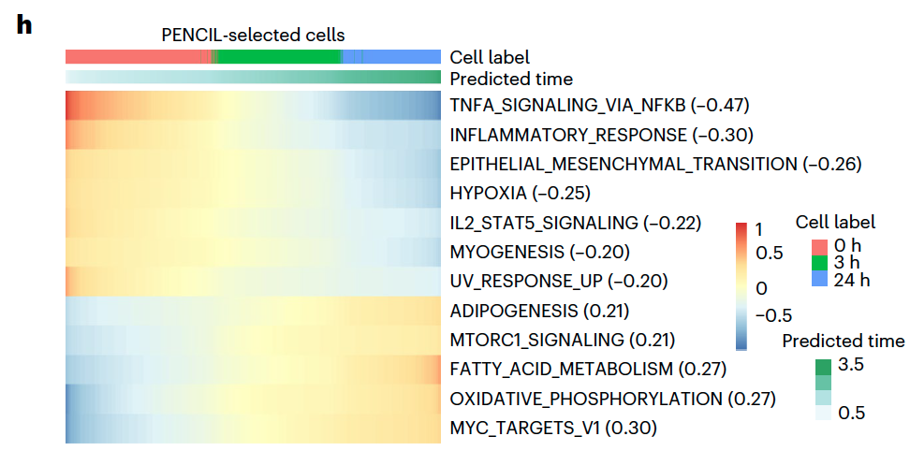
a Identification of ICB response related CD8T cells (tumor: skin; cw = 1:2)
GSE120575 (train)
GSE115978
GSE123813
GSE166181
NR
R
NR
NR
R
NR
R
p = 1*10⁻⁵
p = 1*10⁻⁵
p = 1*10⁻⁵
Curate a new signature predicting icb response
Using GSVA
(0) Test on three datasets
(1) Test on bulk! → many datasets
(2) Test on other cancer types (HNSCC, breast)
b Identification of tumor tissue related CD8T cells (tumor: HNSCC; cw = 2:1)
GSE139324 (train)
GSE164690
GSE162025
GSE180268
PBMC
Tumor
PBMC
PBMC
Tumor
Tumor
GSE200996
Tumor
GSE182227
PBMC
Tumor
Tumor
Marker genes, pathways, enrichment of signatures, ICGs
Figure 2. Predicting phenotype using PENCIL.
Notes:
Hi everyone, today I will present our recent work on predict pan-cancer ICB response using machine learning.

Slide 3
a Identification of sex related CD8T cells (tumor: skin; cw = 2.1:1)
GSE120575 (train)
GSE115978 (test 1)
GSE144236 (test 2)
GSE145328 (test 3)
F
M
M
F
M
F
M
p = 1*10⁻⁵
p = 1*10⁻⁵
p = 1*10⁻⁵
b Identification of HPV infection related CD8T cells (tumor: HNSCC; cw = 1:2)
GSE139324 (train)
GSE182227 (test 1)
GSE200996 (test 2)
GSE180268 (test 3)
HPV-
HPV+
HPV-
HPV+
HPV-
HPV+
p = 1*10⁻⁵
p = 1*10⁻⁵
Figure 3. PENCIL may overfit data.
Notes:
Hi everyone, today I will present our recent work on predict pan-cancer ICB response using machine learning.

Slide 4
GSE166181 (test 4, all PBMC)
GSE120575 (test 5, all tumor tissue)
If train on HNSCC, PENCIL cannot predict tumor/PBMC originate of CD8T cells for melanoma
Notes:
Hi everyone, today I will present our recent work on predict pan-cancer ICB response using machine learning.

Slide 5
a Identification of HPV infection related B cells (tumor: HNSCC; cw = 1.5:1)
GSE139324 (train)
GSE164690 (test 1)
GSE182227 (test 2)
HPV-
HPV+
HPV+
HPV-
HPV+
p = 1*10⁻⁵
p = 1*10⁻⁵
GSE200996 (test 3)
HPV-
Figure 1. Testing reusability of PENCIL on different phenotypes.
Notes:
Hi everyone, today I will present our recent work on predict pan-cancer ICB response using machine learning.

Slide 6
a
UMAP
clustering
UMAP
differential cell abundance test
Cluster annotation
UMAP
Make reference
Predict on new data
Downstream analysis
UMAP
Sample level phenotype prediction
DEG analysis
Pathway analysis
Signature making
b
Phenotype-related cell identification
Dataset 1
UMAP
Cluster annotation
UMAP
Dataset 4
UMAP
Phenotype-related cell identification
Dataset 2
UMAP
Cluster annotation
UMAP
Dataset 5
UMAP
Phenotype-related cell identification
Dataset 3
UMAP
Cluster annotation
UMAP
Dataset 6
UMAP
Training
Test
Figure 2. A simple method identifying phenotype-related cells.
Notes:
Hi everyone, today I will present our recent work on predict pan-cancer ICB response using machine learning.

Slide 7
Notes:
Hi everyone, today I will present our recent work on predict pan-cancer ICB response using machine learning.

Slide 8
Notes:
Hi everyone, today I will present our recent work on predict pan-cancer ICB response using machine learning.

Slide 9
Notes:
Hi everyone, today I will present our recent work on predict pan-cancer ICB response using machine learning.

Slide 10
a PENCIL is sensitive to the class_weights (cw) parameter setting
Non-responder (4301)
Responder (2049)
Non-responder (2560)
Responder (9)
Rejected (3781)
Non-responder (2365)
Responder (1004)
Rejected (2981)
Non-responder (1911)
Responder (18)
Rejected (4421)
True label
cw = 1:1 (default)
cw = 2:1
cw = 4301/2049:1
b PENCIL is sensitive to input gene order
Non-responder (2006)
Responder (674)
Rejected (3670)
Non-responder (2078)
Responder (2)
Rejected (4270)
Non-responder (2425)
Responder (1135)
Rejected (2790)
Non-responder (1843)
Responder (504)
Rejected (4003)
Genes ordered by variance (low to high)
Genes ordered by mean expression (high to low)
Genes ordered by mean expression (low to high)
Genes ordered by name (A to Z)
c PENCIL is sensitive to input cells
Non-responder (1110)
Responder (14)
Rejected (3345)
Non-responder (2958)
Responder (1166)
Rejected (3034)
Non-responder (2767)
Responder (52)
Rejected (5724)
70% samples (using original CD8T annotation)
All samples (CD8T annotated by celltypist)
All samples (CD8T annotated by singleR)
d Generalizability of PENCIL on new data (tumor: skin; phenotype: ICB response)
GSE120575 (train)
GSE115978 (test 1)
GSE123813 (test 2)
GSE166181 (test 3)
NR
R
NR
NR
R
NR
R
p = 1*10⁻⁵
p = 1*10⁻⁵
p = 1*10⁻⁵
e Generalizability of PENCIL on new data (tumor: HNSCC; phenotype: HPV infection)
GSE139324 (train)
GSE180268 (test 1)
GSE182227 (test 2)
GSE200996 (test 3)
HPV-
HPV+
HPV+
HPV-
HPV+
HPV-
p = 1*10⁻⁵
p = 1*10⁻⁵
Figure 1. A general usage report of PENCIL.
Notes:
Hi everyone, today I will present our recent work on predict pan-cancer ICB response using machine learning.

Slide 11
a Identification of ICB response related CD8T cells (tumor: skin)
GSE120575 (train)
GSE115978 (test 1)
GSE123813 (test 2)
GSE166181 (test 3)
NR
R
NR
NR
R
NR
R
p = 1*10⁻⁵
p = 1*10⁻⁵
p = 1*10⁻⁵
b Identification of sex related CD8T cells (tumor: skin)
GSE120575 (train)
GSE115978 (test 1)
GSE144236 (test 2)
GSE145328 (test 3)
F
M
M
F
M
F
M
p = 1*10⁻⁵
p = 1*10⁻⁵
p = 1*10⁻⁵
c Identification of HPV infection related CD8T cells (tumor: HNSCC)
GSE139324 (train)
GSE182227 (test 1)
GSE200996 (test 2)
GSE180268 (test 3)
HPV-
HPV+
HPV-
HPV+
HPV-
HPV+
p = 1*10⁻⁵
p = 1*10⁻⁵
d Identification of tumor tissue related CD8T cells (tumor: HNSCC)
GSE139324 (train)
GSE164690 (test 1)
GSE162025 (test 2)
PBMC
Tumor
PBMC
Tumor
PBMC
Tumor
p = 1*10⁻⁵
p = 1*10⁻⁵
p = 1*10⁻⁵
GSE200996 (test 3)
PBMC
Tumor
p = 1*10⁻⁵
Figure 1. Testing reusability of PENCIL on different phenotypes.
Notes:
Hi everyone, today I will present our recent work on predict pan-cancer ICB response using machine learning.

Slide 12
a Identification of tumor tissue related CD8T cells (tumor: HNSCC; cw = 2:1)
GSE139324 (train)
GSE164690 (test 1)
GSE162025 (test 2)
GSE180268 (test 4)
PBMC
Tumor
PBMC
Tumor
PBMC
Tumor
Tumor
GSE200996 (test 3)
GSE182227 (test 5)
PBMC
Tumor
Tumor
Marker genes, pathways, enrichment of signatures, ICGs
b Identification of ICB response related CD8T cells (tumor: skin; cw = 1:2)
GSE120575 (train)
GSE115978 (test 1)
GSE123813 (test 2)
GSE166181 (test 3)
NR
R
NR
NR
R
NR
R
p = 1*10⁻⁵
p = 1*10⁻⁵
p = 1*10⁻⁵
Curate a new signature predicting icb response
Using GSVA
(0) Test on three datasets
(1) Test on bulk! → many datasets
(2) Test on other cancer types (HNSCC, breast)
Figure 2. Predicting phenotype using PENCIL.
Notes:
Hi everyone, today I will present our recent work on predict pan-cancer ICB response using machine learning.

